Slide 1
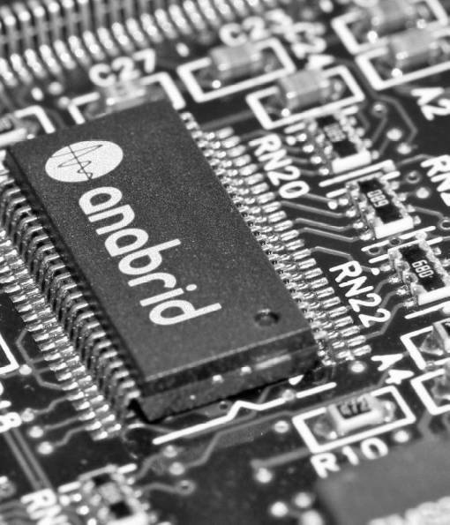
Platforms and Architectures for Analog Computing
Dr. Sven Köppel
koeppel@anabrid.com
2026-05-10
International Supercomputing Conference 2025, Hamburg
Birds of a Feather Session on Analog Computing

Slide 2
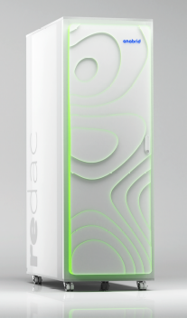
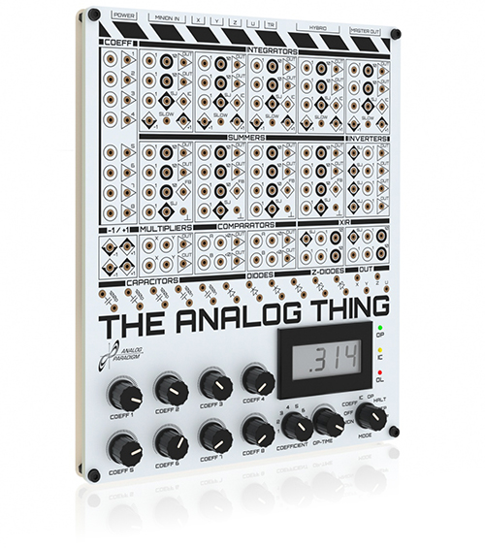
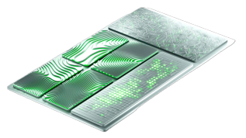

Rediscovering classical Analog Computing
Anabrid resets Moore’s law
The Analog Thing
»Hacker’s toolkit«
REDAC Analog Supercomputer
G-PAC: 65nm CMOS

Slide 3
Reasons why to go analog
Anabrid resets Moore’s law
Low
Latency
From...
* GPUs
* Programmable I/O
* FPGAs (Field Programmable Gate Arrays)
* DSPs (Digital Signal Processors)
Towards ...
→ Novel architectures on
conventional CMOS nodes
100%
Parallelism
Low
Power
Reduced
Complexity

Slide 4
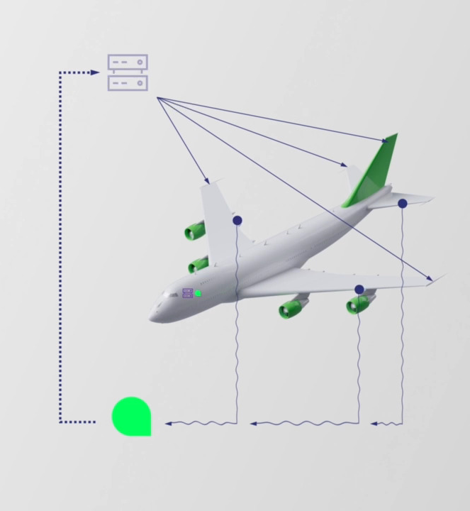

Reasons why to go analog
Anabrid resets Moore’s law
Low
Latency
100%
Parallelism
Low
Power
Reduced
Complexity

Slide 5
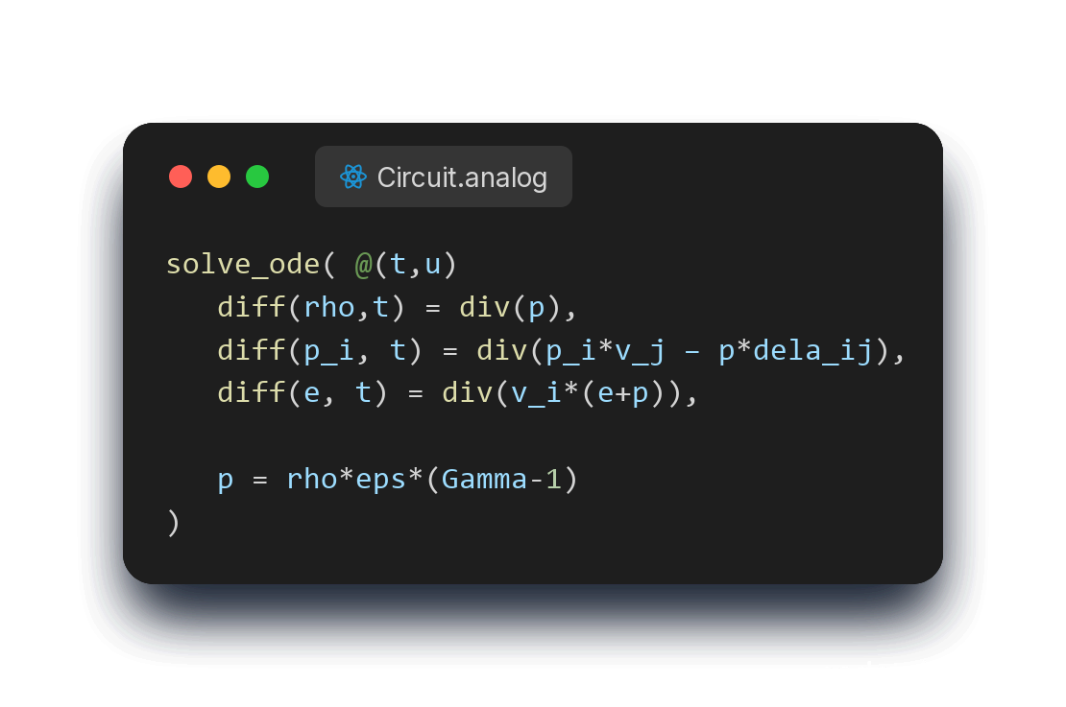
Solving industry problems
solve_ode( @(t,u)
diff(rho,t) = div(p),
diff(p_i, t) = div(p_i*v_j – p*dela_ij),
diff(e, t) = div(v_i*(e+p)),
p = rho*eps*(Gamma-1)
)
Analog 65nm CMOS
[Köppel et al. Advances in Radio Science 2020 / Arxiv:2102.07268]

Slide 6
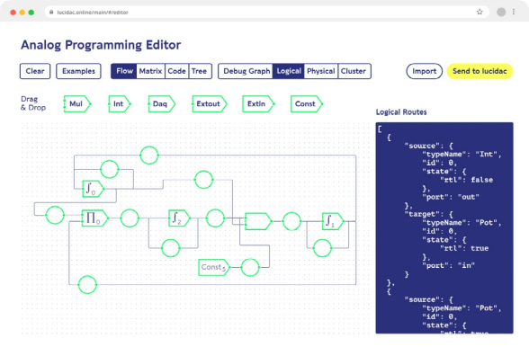
Solving industry problems
solve_ode( @(t,u)
diff(rho,t) = div(p),
diff(p_i, t) = div(p_i*v_j – p*dela_ij),
diff(e, t) = div(v_i*(e+p)),
p = rho*eps*(Gamma-1)
)
Analog 65nm CMOS

Slide 7
Scaling analog CMOS for HPC
Anabrid resets Moore’s law
Circuit Size
[# computing elements]
Cutoff Frequency
[Hz]
Nuclear Fusion
10¹²
10⁹
Growth:
One Decade per Year
...
10⁸
10⁸
Growth:
One Decade per 2 years
HPC
HPC
10⁷
10⁶
10⁷
GPAC2
Drones
10⁵
10⁶
GPAC1
10⁴
REDAC
10³
10⁵
LUCI, REDAC
Embedded
10²
LUCI
Digital limit
10¹
THAT
10⁴
THAT
2020 2022 2024 2026 2028 2030
Time
[year]
2020 2022 2024 2026 2028 2030
Time
[year]

Slide 8








Engaging the HPC community
Scaling Analog in the width
Open Source
APIs matter
Access

Slide 9
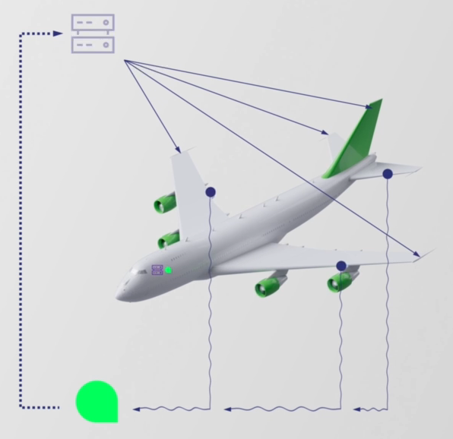
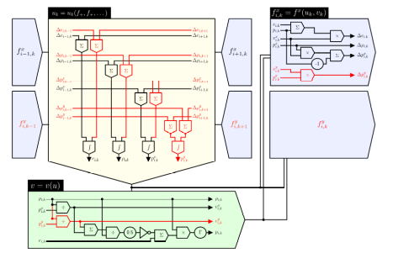
Solving industry problems with Analog CMOS
The General Purpose Analog Computer by Claude Shannon [1941]
Mapping Turing Machines to Polynomial Initial Value Problems
[Sarpeshkar, Neural Computation, 10, 1601-1638 (1998)] [Köppel et al. Advances in Radio Science 2020 / Arxiv:2102.07268] [Bournez, Pouly 2016]

Slide 10
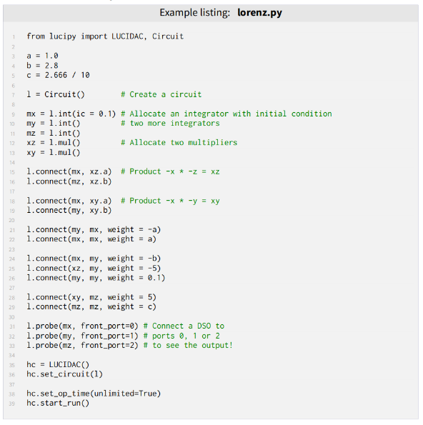
Data flow programming
Configuring op-amp circuits

Slide 11
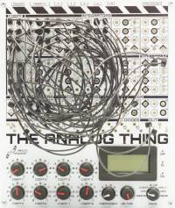

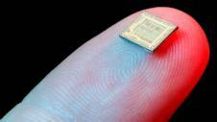
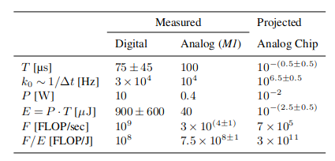
Power and Time to Solution Measurements and Projections for the GPAC
Integrated
Analog
Computer on
Chip
Discrete
Analog
Computer
Integrated Digital benchmark
Time to Solution:
Cutoff frequency (bandwith):
Power consumption:
Energy for computation:
(effective) FLOPs:
Efficiency (FLOPS per Energy):
Köppel et al
[arXiV:2102.07268]

Slide 12
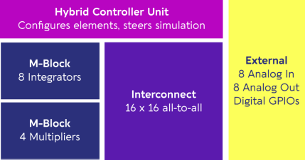
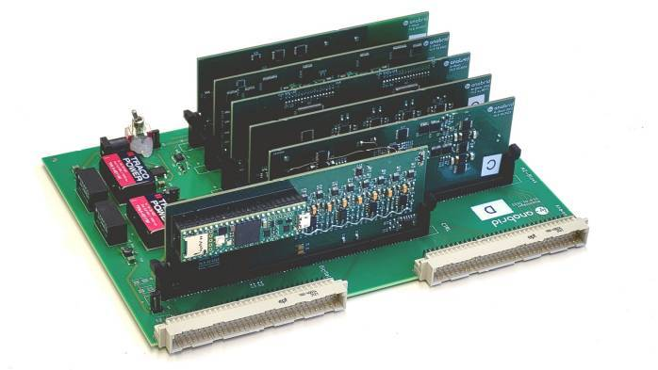
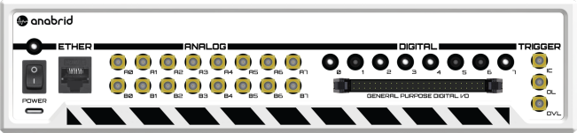
Recent work in hardware: First fully-reconfigurable discrete analog computer, to be released in a few weeks
Precision
Up to 12bit resolution.
DC accuracy 0.1%
AC bandwidth > 1Mhz (cutoff frequency).

